Slide 1


Slide 2
Python - Correlation
It refers to some statistical relationships involving dependence between two data sets.
Examples of dependent phenomena include correlation between the price of the product and the supplied quantity.
Take the iris dataset.
Try to establish the relationship between length and width of sepals and petals of three species of iris flower.

Slide 3
Correlation - Example
import matplotlib.pyplot as plt
import seaborn as sns
df = sns.load_dataset('iris')
#without regression
sns.pairplot(df, kind="scatter")
plt.show()

Slide 4
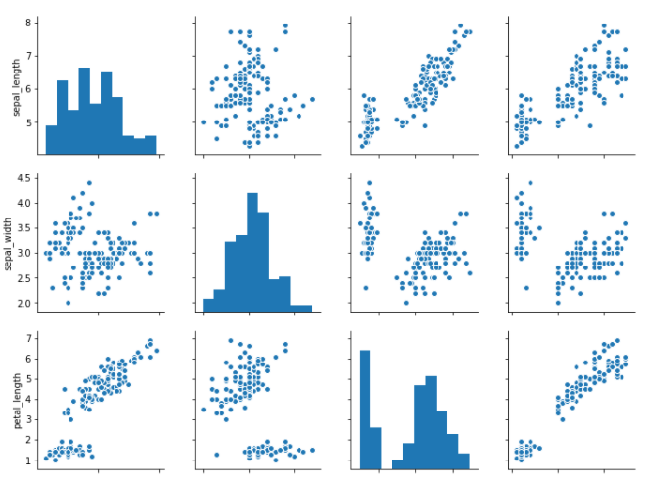
Correlation - Output

Slide 5
Python – Chi – Square - Test
It is a statistical method to find if two categorical variables have significant correlation between them.
Both these variables should be from same population and they should be categorical like Yes/No , Male/Female , Red/Green.etc.
For eg , we can build a data set with observations on people’s ice – cream buying pattern and try to correlate the gender of a person with the flavour of ice – cream they prefer.

Slide 6
Python – Chi – Square - Test
from scipy import stats
import numpy as np
import matplotlib.pyplot as plt
x = np.linspace(0, 10, 100)
fig,ax = plt.subplots(1,1)
linestyles = [':', '--', '-.', '-']
deg_of_freedom = [1, 4, 7, 6]
for df, ls in zip(deg_of_freedom, linestyles):
ax.plot(x, stats.chi2.pdf(x, df), linestyle=ls)

Slide 7
Python – Chi – Square - Test
plt.xlim(0, 10)
plt.ylim(0, 0.4)
plt.xlabel('Value')
plt.ylabel('Frequency')
plt.title('Chi-Square Distribution') plt.legend()
plt.show()

Slide 8
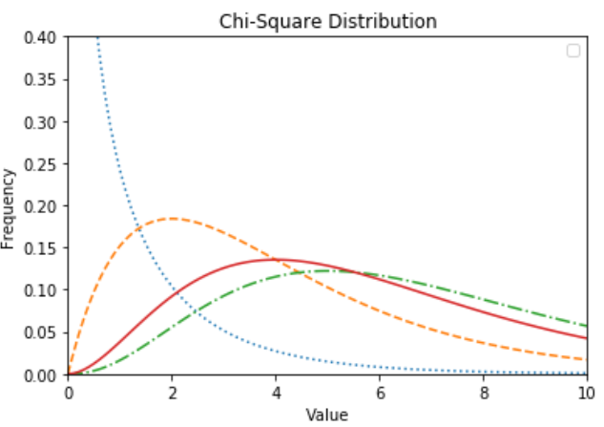
Chi – Square – Distribution - Output

Slide 9
Python – Linear Regression
In linear regression , two variables are related through an equation , where exponent of both these variables is 1.
A linear relationship denotes a straight line when plotted as a graph.
A non – linear relationship where the exponent of any variable is not equal to 1 creates a curve.

Slide 10
Python – Linear Regression
import seaborn as sb
from matplotlib import pyplot as plt
df = sb.load_dataset('tips')
sb.regplot(x = "total_bill", y = "tip", data = df)
plt.show()

Slide 11
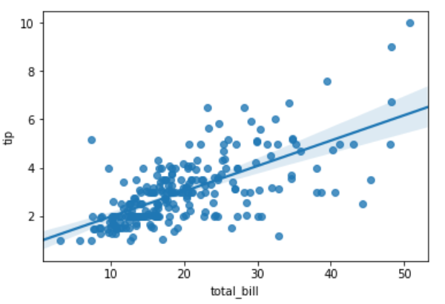
Linear Regression - Output

Slide 12
THANKS
Further Information:
Senthil Kumar – 98409 74406
Srinivasan – 7010888841
Kumarasamy - 8925533489
www.pantechelearning.com | training@pantechmail.com

